Slide 1
Data Mining
Model Overfitting

Slide 2
Classification Errors
Training errors: Errors committed on the training set
Test errors: Errors committed on the test set
Generalization errors: Expected error of a model over random selection of records from same distribution
Notes:
The errors committed by a classification model are generally divided into two
types: training errors and generalization errors. Training error, also
known as resubstitution error or apparent error, is the number of misclassification
errors committed on training records, whereas generalization error
is the expected error of the model on previously unseen records.

Slide 3
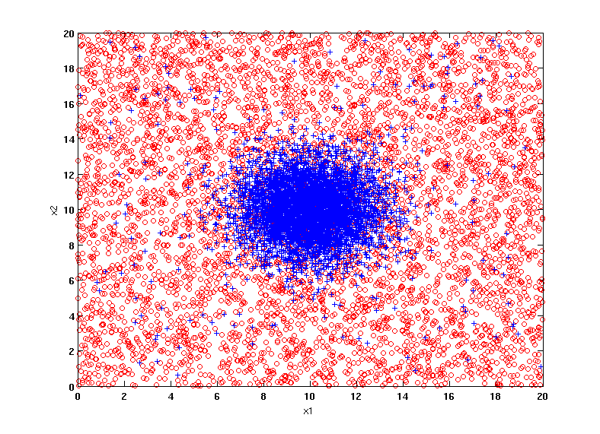
Example Data Set
Two class problem:
+ : 5400 instances
5000 instances generated from a Gaussian centered at (10,10)
400 noisy instances added
o : 5400 instances
Generated from a uniform distribution
10 % of the data used for training and 90% of the data used for testing

Slide 4
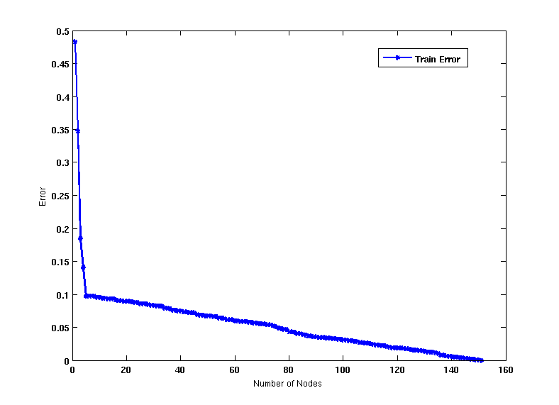
Increasing number of nodes in Decision Trees
Notes:
Notice that the training and test error rates of the model are large when the
size of the tree is very small. This situation is known as model underfitting

Slide 5
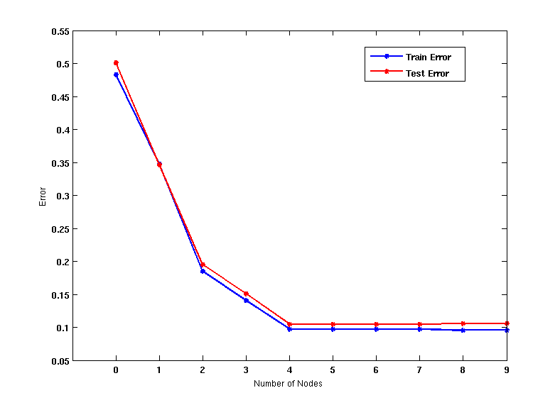
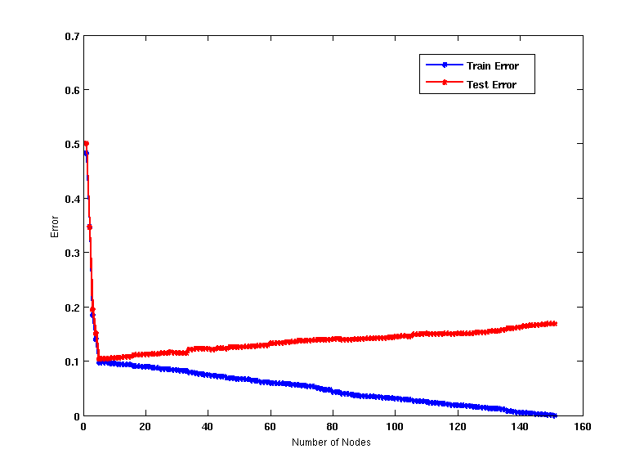
Model Underfitting and Overfitting
As the model becomes more and more complex, test errors can start increasing even though training error may be decreasing
Underfitting: when model is too simple, both training and test errors are large
Overfitting: when model is too complex, training error is small but test error is large

Slide 6
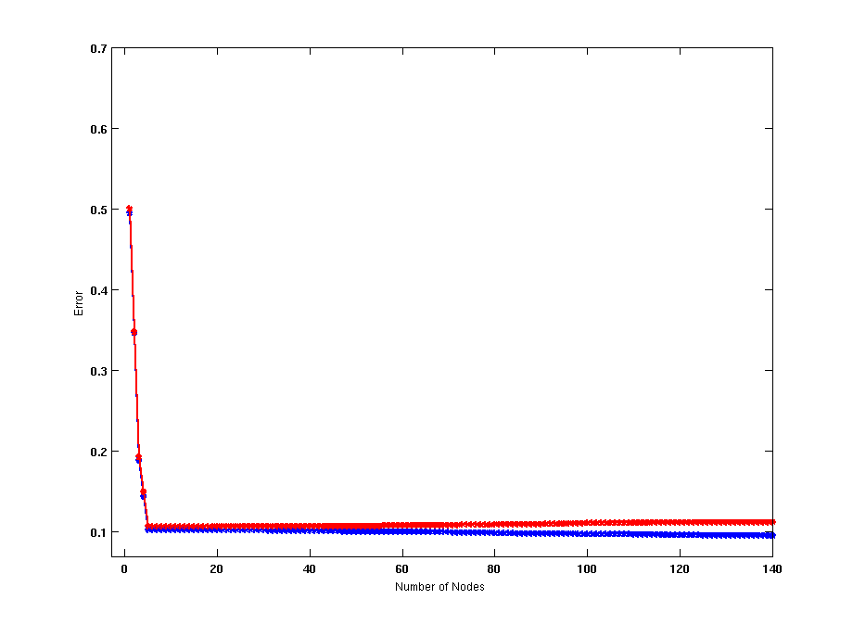
Model Overfitting – Impact of Training Data Size
Using twice the number of data instances
Increasing the size of training data reduces the difference between training and testing errors at a given size of model

Slide 7
Model Overfitting – Impact of Training Data Size
Decision Tree with 50 nodes
Decision Tree with 50 nodes
Using twice the number of data instances
Increasing the size of training data reduces the difference between training and testing errors at a given size of model

Slide 8
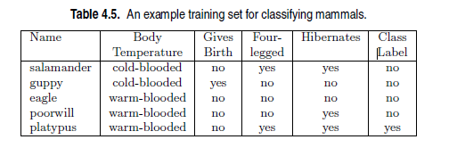
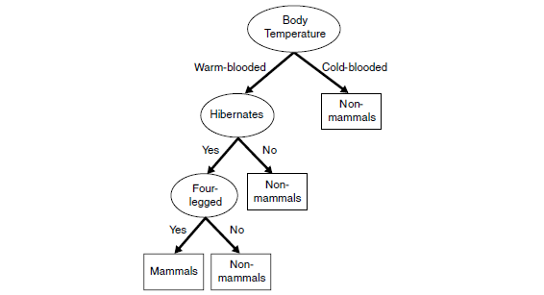
Reasons for Model Overfitting
Not enough training data
Notes:
Humans, elephants, and dolphins are misclassified because the decision tree
classifies all warm-blooded vertebrates that do not hibernate as non-mammals.
The tree arrives at this classification decision because there is only one training
record, which is an eagle, with such characteristics. This example clearly
demonstrates the danger of making wrong predictions when there are not
enough representative examples at the leaf nodes of a decision tree.

Slide 9
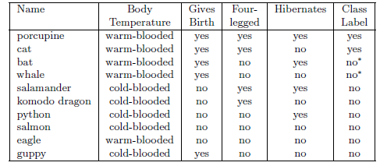
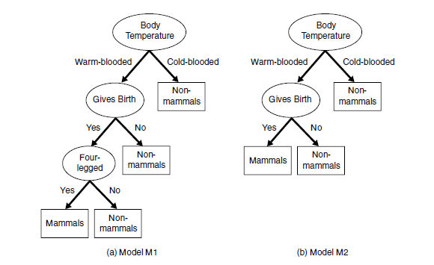
Reasons for Model Overfitting
Overfitting Due to Presence of Noise
Notes:
Consider the training and test sets shown in Tables 4.3 and 4.4 for the mammal
classification problem. Two of the ten training records are mislabeled: bats
and whales are classified as non-mammals instead of mammals.
A decision tree that perfectly fits the training data is shown in Figure
4.25(a). Although the training error for the tree is zero, its error rate on
the test set is 30%. Both humans and dolphins were misclassified as nonmammals
because their attribute values for Body Temperature, Gives Birth,
and Four-legged are identical to the mislabeled records in the training set.
Spiny anteaters, on the other hand, represent an exceptional case in which the
class label of a test record contradicts the class labels of other similar records
in the training set. Errors due to exceptional cases are often unavoidable and
establish the minimum error rate achievable by any classifier.

Slide 10
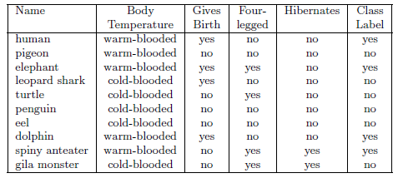
Test
Overfitting Due to Presence of Noise
Notes:
the test set is 30%. Both humans and dolphins were misclassified as nonmammals
because their attribute values for Body Temperature, Gives Birth,
and Four-legged are identical to the mislabeled records in the training set.
Spiny anteaters, on the other hand, represent an exceptional case in which the
class label of a test record contradicts the class labels of other similar records
in the training set. Errors due to exceptional cases are often unavoidable and
establish the minimum error rate achievable by any classifier.
In contrast, the decision tree M2 shown in Figure 4.25(b) has a lower test
error rate (10%) even though its training error rate is somewhat higher (20%).
It is evident that the first decision tree, M1, has overfitted the training data
because there is a simpler model with lower error rate on the test set. The
Four-legged attribute test condition in model M1 is spurious because it fits
the mislabeled training records, which leads to the misclassification of records
in the test set.

Slide 11
Notes on Overfitting
Overfitting results in decision trees that are more complex than necessary
Training error does not provide a good estimate of how well the tree will perform on previously unseen records
Need ways for estimating generalization errors

Slide 12
Model Selection
Performed during model building
Purpose is to ensure that model is not overly complex (to avoid overfitting)
Need to estimate generalization error
Using Validation Set
Incorporating Model Complexity

Slide 13
Model Selection: Using Validation Set
Divide training data into two parts:
Training set:
use for model building
Validation set:
use for estimating generalization error
Note: validation set is not the same as test set
Drawback:
Less data available for training
Notes:
Typically, two-thirds of the
training set is reserved for model building, while the remaining one-third is
used for error estimation.

Slide 14
Model Selection: Incorporating Model Complexity
Rationale: Occam’s Razor
Given two models of similar generalization errors, one should prefer the simpler model over the more complex model
A complex model has a greater chance of being fitted accidentally
Therefore, one should include model complexity when evaluating a model
Gen. Error(Model) = Train. Error(Model, Train. Data) +
x Complexity(Model)

Slide 15
Estimating the Complexity of Decision Trees
Pessimistic Error Estimate of decision tree T with k leaf nodes:
err(T): error rate on all training records
Ω: trade-off hyper-parameter
Relative cost of adding a leaf node
k: number of leaf nodes
N_{train}: total number of training records

Slide 16
Estimating the Complexity of Decision Trees: Example
e(T_{L}) = 4/24
e(T_{R}) = 6/24
Ω = 1
e_{gen}(T_{L}) = 4/24 + 1*7/24 = 11/24 = 0.458
e_{gen}(T_{R}) = 6/24 + 1*4/24 = 10/24 = 0.417

Slide 17
Model Selection for Decision Trees
Pre-Pruning (Early Stopping Rule)
Stop the algorithm before it becomes a fully-grown tree
Typical stopping conditions for a node:
Stop if all instances belong to the same class
Stop if all the attribute values are the same
More restrictive conditions:
To do this, a more restrictive stopping condition must be used; e.g., stop expanding a leaf node when the observed gain in impurity measure (or improvement in the estimated generalization error) falls below a certain threshold.
Notes:
The advantage of this approach is that it avoids generating
overly complex subtrees that overfit the training data. Nevertheless, it is
difficult to choose the right threshold for early termination. Too high of a
threshold will result in underfitted models, while a threshold that is set too low
may not be sufficient to overcome the model overfitting problem. Furthermore,
even if no significant gain is obtained using one of the existing attribute test
conditions, subsequent splitting may result in better subtrees.

Slide 18
Model Selection for Decision Trees
Post-pruning
Grow decision tree to its entirety
Subtree replacement
Trim the nodes of the decision tree in a bottom-up fashion
If generalization error improves after trimming, replace sub-tree by a leaf node
Class label of leaf node is determined from majority class of instances in the sub-tree
Notes:
Trimming can be done by
replacing a subtree with (1) a new leaf node whose class label is determined
from the majority class of records affiliated with the subtree, or (2) the most
frequently used branch of the subtree. The tree-pruning step terminates when
no further improvement is observed. Post-pruning tends to give better results
than prepruning because it makes pruning decisions based on a fully grown
tree, unlike prepruning, which can suffer from premature termination of the
tree-growing process. However, for post-pruning, the additional computations
needed to grow the full tree may be wasted when the subtree is pruned.

Slide 19
Model Evaluation
Purpose:
To estimate performance of classifier on previously unseen data (test set)
Holdout
Reserve k% for training and (100-k)% for testing
Random subsampling: repeated holdout
Cross validation
Partition data into k disjoint subsets
k-fold: train on k-1 partitions, test on the remaining one
Leave-one-out: k=n

Slide 20
Cross-validation Example
3-fold cross-validation

Slide 21
Variations on Cross-validation
Repeated cross-validation
Perform cross-validation a number of times
Gives an estimate of the variance of the generalization error
Stratified cross-validation
Guarantee the same percentage of class labels in training and test
Important when classes are imbalanced and the sample is small
Use nested cross-validation approach for model selection and evaluation

